Slide 1
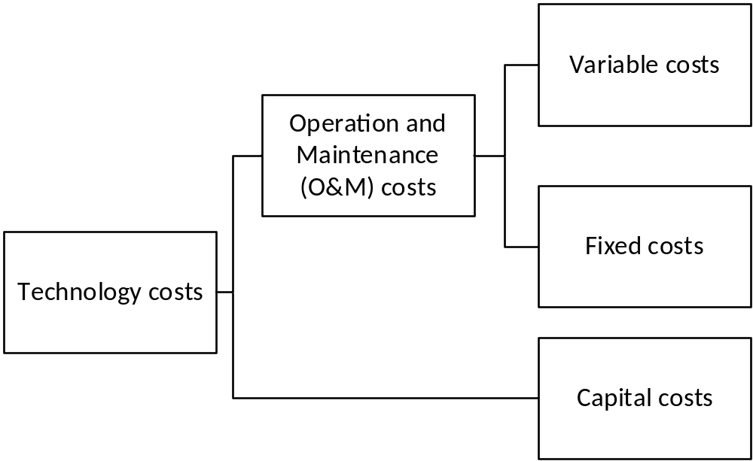
Technology representation in OSeMOSYS:
Costs
In OSeMOSYS, costs are split into CapitalCost, FixedCost and VariableCost
Fuel
Other consumables (e.g. chemicals, detergents, etc.)
Salaries
Taxes and insurance
Fixed fuel costs
Depreciation
Return on investment
Other one-time fixed charges

